Slide 1
Microsoft R Server on Spark
Ali Zaidi
Data Scientist
Machine Learning Education Team

Slide 2
The Microsoft R Advanced Analytics Stack

Slide 3
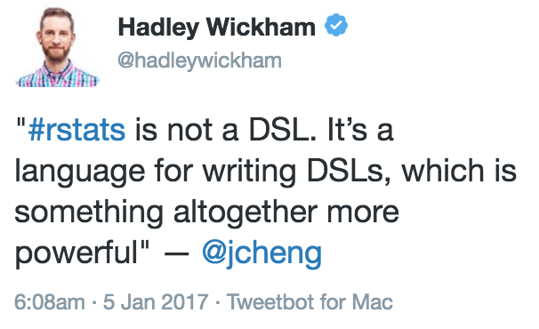
R as an Interface
[Y]ou should understand R as a user interface, or a language that’s capable of providing very good user interfaces
– JJ Allaire, RStudio

Slide 4
Distributions of R
Microsoft R Server
Enterprise-class high-performance analytics distribution
Parallel external memory algorithms with the RevoScaleR library
No threads limits
Out-of memory computation with the XDF file format
Deployment capabilities through the mrsdeploy package
Commercial support
Available in Linux (Red Hat, CentOS), Windows, SQL Server, Spark, Hadoop and Teradata
Battle-tested Microsoft Research libraries for state-of-the-art machine learning with MicrosoftML
CRAN-R
a.k.a., GNU-R
Single-threaded
In-memory
10K+ packages
Interfaces to C++, C, and Fortran for speed
Cross-platform
MRO
GNU-R + Intel MKL = multi-threaded linear algebra
100% CRAN-R compatible
Reproducible R toolkit with the checkpoint package
Free
R Client
High-performance analytics with the RevoScaleR package
Two-threads
Deployment capabilities through the mrsdeploy package
Free, windows
In-memory distributions
Out-of-memory, multicore, multi-node, Parallel Algorithms

Slide 5
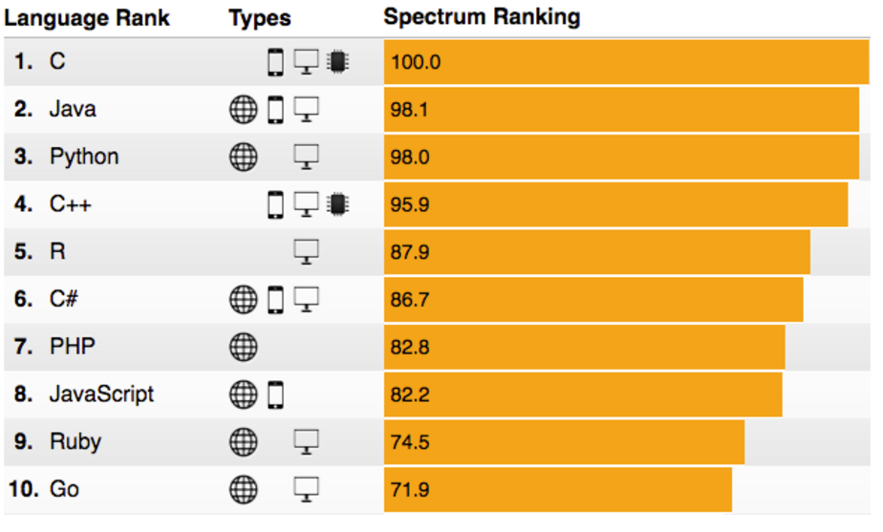
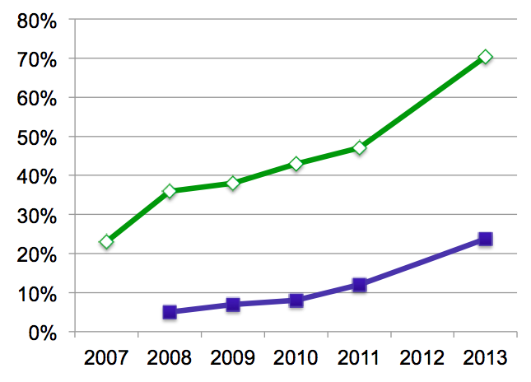
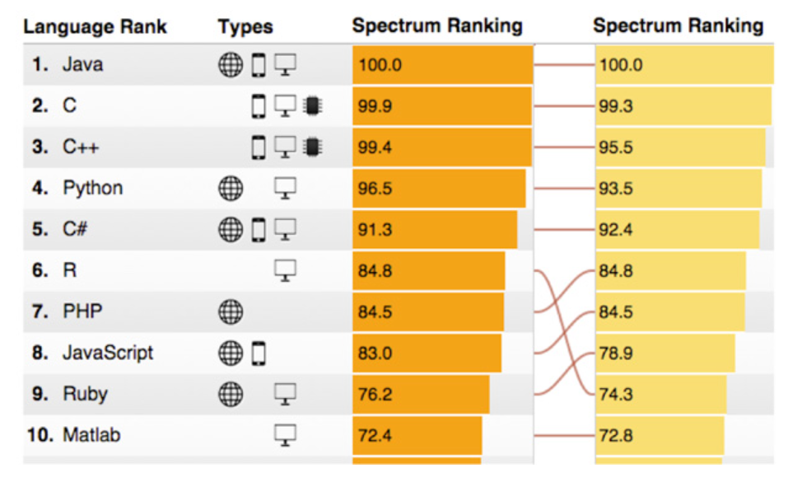
R’s popularity is growing rapidly
Language Popularity
IEEE Spectrum Top Programming Languages
R Usage Growth
Rexer Data Miner Survey, 2007-2013
2015
2014
80%
0%
2007
2008
2009
2010
2011
2012
2013
Primary Tool
Use for Data Science
Rexer Data Miner Survey
IEEE Spectrum 2014 – 2016
Notes:
Slide objective
Introduce the popularity of the R language vs. other analytics languages.
Talking points
R is enjoying an unstoppable wave of popularity
In 2015, it moved from the #9 most frequently used language to #6.
Only general purpose languages are more frequently used than R.
Notes:

Slide 6
Microsoft R Server
MRS extends open-source R to allow:
Multi-threading
Matrix operations, linear algebra, and many other math operations run on all available cores
Parallel processing
ScaleR functions utilize all available resources, local or distributed
On-disk data storage
RAM limitations lifted – Break Through Your Memory Barrier!

Slide 7
Microsoft R Server family
From Data To Action On Premises
Data Sources
People
Cortana Intelligence
+
Apps
Apps
Sensors and devices
Automated Systems
Microsoft R Server & SQL R Services
DATA
INTELLIGENCE
ACTION
Notes:
Slide Objective
Introduce the two product families and transition to high-level product overviews.
Talking Points
Microsoft brings two complementary product lines to bear on the challenges of Advanced Analytics.
Cortana Intelligence Suite provides a rich, end-to-end, cloud-based advanced analytics capability.
Microsoft’s R Server and SQL R Services products leverage a predominantly on-premises point of view – designed for users with significant investments in on-premises data, data repositories, and application portfolios.
Notes
Avoid being dragged into a direct comparison of the two products. There is not a clear answer until much more is known about the audience and their challenges.
If you get dragged into this discussion you may well lose the remainder of your time.

Slide 8

What is
Language
Platform
A statistics programming language
A data visualization tool
Open source
Community
2.5+M users
Taught in most universities
New and recent grad’s use it
Thriving user groups worldwide
Ecosystem
10,000+ free algorithms in CRAN
Scalable to big data
Rich application & platform integration
Notes:
Slide objective
Establish that R is a language is as important for the community that uses it an the capabilities written to extend it than the language itself.
Talking points
Part 1 of the R World is The R language, developed specifically for data analysis – particularly among statisticians and mathematicians.
[optional points]:
Developed in New Zealand, release in roughly 2000.
Maintained by the R Foundation which releases new editions of R every few weeks.
Licensed under GPL open source license.
R directly supports complex data manipulation operations making them extremely simple for users, particularly those with greater depth in statistics and mathematics than in computer science.
Huge community of users across industry, government and academia use R daily.
There are R user groups in most major cities. Some of them very active and very large. Suggest that users look at MeetUp for local groups that meet regularly.
Most important to the value of R is the huge repository of freely exchanged, algorithms, techniques, scripts, adapters, techniques, training available.
Introduce CRAN: “The Comprehensive R Archive Network”.
Data access & integration
Data transformation
Data profiling
Data visualization
Predictive analytics
Machine Learning
CRAN contains over 7000 (and growing) contributed packages. Many algorithms, test data, comments on usage, etc. One package contains hundreds of algorithms packaged as a library.
All are designed to run with the R language.
CRAN is the largest but not the only. Thousands of additional algorithms, visualizations and tools are available from BioConductor, GitHub and other repositories.
Notes

Slide 9
Challenges posed by open source R
?
?
$?
Limited Data Scale
Inadequate
Modeling Performance
Lack of Commercial Support
Complex Deployment
Processes
Notes:
Slide objective
Introduce how the use of open source R for machine learning and advanced analytics has been limited to a narrow user base of data scientists. Related to this, also discuss how many challenges and complexities remain for advanced analytics in the marketplace.
Talking points
Today, advanced analytics using open source R are being performed only by highly trained and specialized data scientists, mathematicians, and analysts who can create and nurture these models. This means that many challenges and complexities remain in the marketplace.
First, many companies cannot negotiate the increasing costs of specialized talent, infrastructure, and machine learning tools that make total cost of ownership (TCO) and return on investment (ROI) uncertain.
Second, siloed and cumbersome data management restricts access to data and poses limitations on what data can be included in models.
Third, trying to collaborate across complex and fragmented technologies tends to limit agility and reduce participation in exploring data and building models. People end up struggling with the technology instead of focusing on the business problem at hand.
Finally, many models never achieve business value because it’s so difficult to deploy them to stable production environments. If you can imagine spending hundreds of thousands of dollars on a solution and having it never go into production, you can see why machine learning has been so niche up to this point.
Notes

Slide 10
R from Microsoft brings
Peace of mind
Efficiency
Speed and scalability
Flexibility and agility
Notes:
Slide objective
At a high level, describe the evolution of predictive analytics technology and its current state in the marketplace. Also, introduce the related value proposition of combining the R programming language with the Microsoft data platform.
Talking points
Data is the currency of modern business; from the cloud to on-premises and everything in between, access to data anytime, anywhere from varied sources has become a requirement for successful planning and operation. Today, the R open source programming language enables organizations to move beyond reacting to data after the fact, and begin predicting results and gathering proactive insights to help plan ahead.
Basically, an evolution is taking place.
The rise of machine learning and advanced analytics gives us the ability not only to look at historical data to understand what happened and why, but also to harness predictive analytics to peer into the future. With predictive analytics, we can better understand what is likely to happen and identify what actions should be taken so businesses can automate outcomes.
Again, to date, R has been available only as open source. But now that’s changed, and Microsoft is introducing a new value proposition.
With R from Microsoft, you get:
peace of mind,
Efficiency,
Speed and scalability,
And flexibility and agility.
Notes

Slide 11

Microsoft R portfolio
Microsoft R portfolio
Community
Commercial
SQL Server
R Services
R Open
R Server
Windows
Linux
Hadoop
Teradata
Spark
Notes:
Slide objective
Show broad commitment to R by preserving freely available, enhanced editions, Windows and SQL Server editions and R Server editions for leading EDWs, Linux and Hadoop platforms.
Differentiate free, open editions from commercial by mentioning availability of commercial 24x7 support, and enhancements to support very large scale data analytics at speed.
Talking points
Notes

Slide 12
Microsoft R Scales to Big Data for Enterprises
Escapes R’s traditional memory limits
Scales predictive modeling using parallelization
Distributes computation cores & nodes
Minimizes data movement using in-database, in-MapReduce and in-Apache Spark execution
f(x)
Notes:
First, Cortana Intelligence provides services to bring data in, so that you can analyze it. It can be any type of data – structured, unstructured, stored in relational or non-relational sources, you name it. This can be data from inside your business, from traditional customer and operations data to IoT data streaming in from devices and sensors. It can also be data from external sources like, social media feeds. That data can be fed into various storage locations, and can be used in whatever downstream analytics and business applications you see fit.
The data brought in can then be stored in flexible big data storage services. Because it’s in the cloud, you can achieve massive global scale, and can easily scale up or down depending on demand. The cloud gives you an almost infinite set of computing resources. This means that you never have to worry about straining your capacity when high-volume events occur, whether they’re planned or unplanned. That might be a peak season of the year, an unexpectedly popular promotion that sets off a social media deluge, you name it. Cloud is key to handling massive amounts of data in a cost-effective way.
And because it’s all in the cloud, you only pay for what you use. This in itself saves you money for anything that has variable computing needs. For some organizations, there is also an additional benefit of changing CapEx to OpEx, which frees up capital from infrastructure investments so it can be put to other uses.
<Transition>: Next, let’s cover analytics.
Slide objective
.
Talking points
.
Notes

Slide 13
R APIs for Spark
SparkR
ASF, Apache-licensed
Ships with Apache-Spark since 1.4x
SparkSQL and SparkML support through RPC
UDF support through gapply, dapply, spark.lapply
sparklyr
On CRAN/github (0.5)
Apache-licensed
SparkSQL and SparkML support through DBI, dplyr and RPC
UDF support announced (PR#78)
Remote execution with Livy
Extensions!
RxSpark
Commercially licensed
Deploy RevoScaleR in Spark clusters
Interop with sparklyr
PEMA support
Consume Parquet, and Hive Tables
Robust UDF support with rxDataStep, rxExec, rxExecBy, and foreach
Current version: 9.1

Slide 14
MRS in Different Contexts
On a workstation, that means:
All available cores will be used for math operations and parallel processes
Hard drive capacity sets limit for data size, not RAM
On a cluster:
Parallel utilization of all available nodes
Distributed file systems like HDFS greatly expand possible data sizes

Slide 15
MRS in Different Contexts
Code written on a workstation will run on a cluster by tweaking a single function call:
# Use your local computer:
rxSetComputeContext( LocalParallel() )
# Switch to your cluster:
rxSetComputeContext( RxSpark(...) )

Slide 16
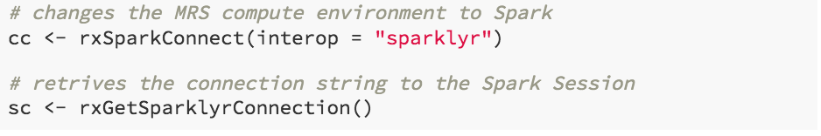
Sharing a Spark Session
In Microsoft R Server 9.1 (MRS), you can create a single Spark Session from MRS that connects with sparklyr to that session
Allows you to share data across MRS and sparklyr, and use functions from either package in the same pipeline
can also share the session with any other sparklyr extension packages, like rsparkling
MRS has readers for Hive, using the RxHiveData source reader, so anything you persist to the Hive metastore from SparkSQL/sparklyr can be consumed by MRS

Slide 17
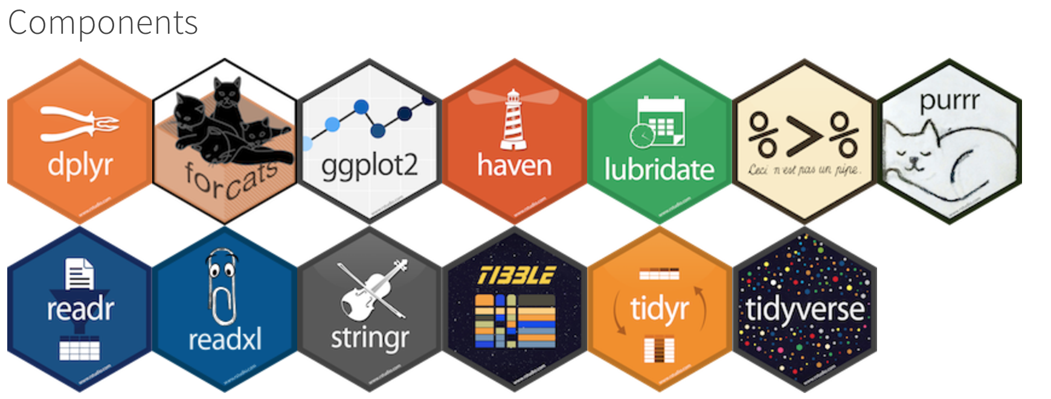
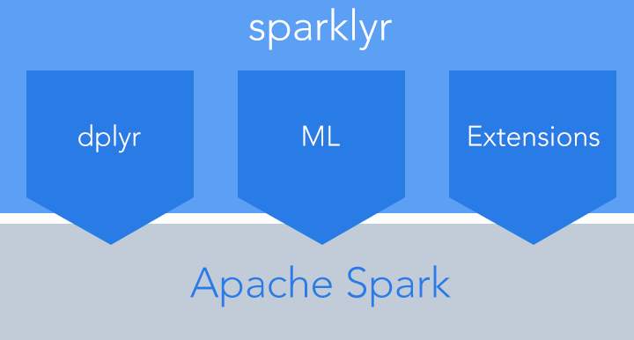
Sparklyr’s Role in the Tidyverse

Slide 18
Spark Abstractions for R
RDD;
DataFrame;
Transformers;
a function that takes a RDD/DataFrame in and pushes another RDD/DataFrame out
Actions;
a function that takes a RDD/DataFrame in, and puts anything else out
Distributed immutable list;
Distributed data.frame:
tbl_spark, tbl_sql
Lazy Computations;
dplyr, sql, sdf_transforms, ml_transformer Eager Queries;
dplyr::collect, head

Slide 19
How MRS Works
Parallel External Memory Algorithms (PEMAs)
A chunk/subset of data is extracted from the main dataset
An intermediate result is calculated from that chunk of data
The intermediate results are combined into a final dataset

Slide 20
Distributed Computing with MRS
MRS has two packages for distributed machine learning and predictive modeling:
RevoScaleR
Primarily written in C++
Spark extensions written in Scala
MicrosoftML
Primarily written in C#
CLR bridge to MRS process – (BxlServer)
Both packages are executed as parallel external memory algorithms, and can consume a variety a data sources
Hive tables
Parquet
Text
ODBC, and many more

Slide 21
From sparklyr to MRS
Parquet,
spark_write_parquet
RxParquetData
Spark DataFrame,
tbl_spark
MRS
rxDataStep(
outFile = xdfd)
Hive
sdf_register
RxHive

Slide 22
Available Algorithms
Linear regression (rxLinMod)
Generalized linear models (rxLogit, rxGLM)
Decision trees (rxDTree)
Gradient boosted decision trees (rxBTree)
Decision forests (rxDForest)
K-means (rxKmeans)
Naïve Bayes (rxNaiveBayes)
Note: models available in open-source R packages won’t be made parallel automatically

Slide 23


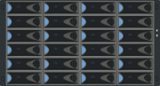



How Does Remote Compute Context Work?
Microsoft R Client
Microsoft R Server
Analyze Blocks In Parallel
Load Block At A Time
Big Data
R IDE or command-line
Distribute Work, Compile Results
REMOTE CONTEXT
Work
AlgorithmMaster
Predictive Algorithm
Results
Console
“Pack and Ship” Requests to Remote Environments
Microsoft R Server functions
A compute context defines where to process.
E.g. remote context like Hadoop Map Reduce
Microsoft R functions prefixed with rx
Current set compute context determines processing location
Copyright Microsoft Corporation. All rights reserved.

Slide 24

Parallelized, Remote Execution Algorithms
Data Step
Data import – Delimited, Fixed, SAS, SPSS, OBDC
Variable creation & transformation
Recode variables
Factor variables
Missing value handling
Sort, Merge, Split
Aggregate by category (means, sums)
Statistical Tests
Chi Square Test
Kendall Rank Correlation
Fisher’s Exact Test
Student’s t-Test
Variable Selection
Stepwise Regression
Simulation
Simulation (e.g. Monte Carlo)
Parallel Random Number Generation
Sampling
Subsample (observations & variables)
Random Sampling
Cluster Analysis
K-Means
Descriptive Statistics
Min / Max, Mean, Median (approx.)
Quantiles (approx.)
Standard Deviation
Variance
Correlation
Covariance
Sum of Squares (cross product matrix for set variables)
Pairwise Cross tabs
Risk Ratio & Odds Ratio
Cross-Tabulation of Data (standard tables & long form)
Marginal Summaries of Cross Tabulations
Predictive Models
Sum of Squares (cross product matrix for set variables)
Quantiles (approx.)
Generalized Linear Models (GLM) exponential family distributions: binomial, Gaussian, inverse Gaussian, Poisson, Tweedie. Standard link functions: cauchit, identity, log, logit, probit. User defined distributions & link functions.
Covariance & Correlation Matrices
Logistic Regression
Classification & Regression Trees
Predictions/scoring for models
Residuals for all models
Classification
Decision Trees
Decision Forests
Gradient Boosted Decision Trees
Naïve Bayes
Combination
rxDataStep
rxExec
PEMA-R API Custom Algorithms

Slide 25
MRS’s Native Data Format: The XDF File
Chunk-oriented
Easy to distribute to nodes
Fast to append
Column-oriented
Fast retrieval of variables
Pre-computed metadata

Slide 26
Moving Data to Disk
Text files, binary files, databases…
MRS can work directly with many of these formats
Advantages and disadvantages to each
The eXternal Data Frame file (XDF)

Slide 27
Importing to XDF
rxImport
inData
outFile
varsToKeep, varsToDrop
numRows
rowSelection
overwrite
append

Slide 28

R Server in Hadoop
Traditionally R Server supported Hadoop MR as a Hadoop compute context
This meant R Server functions ran on Hadoop as a MapReduce Job under YARN
Spark posits itself as a better execution engine for iterative jobs
R Server on MR is slowed by startup overhead and file-based communications

Slide 29
How Spark Works in Comparison to Hadoop
Spark has an advanced DAG execution engine that supports acyclic data flow and in-memory computing.
While Hadoop has overheads:
Frequent read/write data to HDFS. For each Mapper/Reducer function, input data and output path should both in HDFS. Then multi-iteration algorithms get blocked by the network and disk I/O.
Unnecessary data shuffling. Sometimes Hadoop tries to reshuffle data (move data from one host to another host) across cluster while Spark tries to keep data in local compute.

Slide 30

R Server on Spark
Spark permits data to be retained in memory across iterations of ML pipelines through Resilient Distributed Datasets (RDD) and Spark Dataframes
R Server on Spark is built on Spark’s high performance distributed backend w/o the file-based overhead of MR
How it works:
Each rx function invokes a new spark application that persists for duration of rx’s lifetime
XDFDs passed to worker nodes as RDD’s to load and retain data across iterations
Cache data in RDD between iterations
Master and worker nodes communicate with Scala API for communication
Saves temporary files in tmpfs (in-memory file system on Linux)
Supports persistent mode in Spark Context to reduce overhead of launching the process.
Notes:
Major improvement over HadoopMR:
pre-load text data into composite xdf for multi-iterations algorithm
xdfs are loaded into RDD (in memory) which can be reused across all iterations
RDDs are repartitioned to gain better task assignment across all Spark executors
move .input and IRO files (BxlServer input and output) from HDFS to local FS to avoid HSFD write overwrite
xdfd converted to RDDs and sent to executor along with metadata
executor pick ups RDDs
scala code saves RDD in tmpfs (volatile memory)
executor reads in RDD and metadata and creates IRO1
map will finish by saving to reduced local final result

Slide 31
HDInsight + R Server: Managed Hadoop for advanced analytics
Hadoop: lingua franca for BigData
Spark (Standard)
Integrated notebooks experience
Upgraded to latest Version 1.6
R Server
Leverage R skills with massively scalable algorithms and statistical functions
Reuse existing R functions over multiple machines
Scala/Java
Notebooks
R
Spark
(data manipulation)
R Server
(big computation)
Spark and Hadoop
Blob Storage
Data Lake Storage

Slide 32




R Server HDInsight Architecture
R Server Distributed Processing:
Master R process on Edge node
Apache YARN and Spark
Worker R processes on Data nodes
Data Scientists
Edge Node
Data Nodes
R
R
R
R
R
Head Nodes
R
R
R
R
R
R Server
RStudio Server (optional)

Slide 33

Faster data, faster results
140
Spark is the 2014 Sort Benchmark winner.
3x faster than 2013 winner (Hadoop).
120
Hadoop
100
80
Spark is fast not just for in-memory, but for on-disk computation too.
Running time(s)
60
40
20
Spark
0
0.9
Logistic regression
Logistic regression on a 100-node cluster with 100 GB of data.
tinyurl.com/spark-sort
Notes:
Objective: This slide highlights the importance of speed when data processing is needed.
Talking points:
In iterative applications, the same data is accessed repeatedly, often in a sequence.
Most machine learning algorithms and streaming applications (that maintain an aggregate state) are iterative in nature.

Slide 34
Spark v. MapReduce
140
How??
Caching data to memory can avoid extra reads to disk
Scheduling of tasks from 15 – 20 s to 15 – 20 ms
Resources are dedicated to the entire life of the application
Can link multiple maps and reduces together without having to rewrite intermediate data to HDFS
Every reduce doesn’t require a map
120
Hadoop
100
80
Running time(s)
60
40
20
Spark
0
0.9
Logistic regression

Slide 35
Performance: R Server on HDInsight Spark Scales linearly to billions of rows
Elapsed Time (seconds)
2.2 TB
Billions of rows
Preliminary results

Slide 36
Performance: R Server on HDInsight Spark Spark is much faster than MapReduce and Local
36X
Millions of rows
Billions of rows
Preliminary results

Slide 37
Using RxSpark
RxSpark(
hdfsShareDir, localShare, clientShare,
ssh, ssh…,
spark_config…,
)
Can deploy remotely using ssh connection parameters
Can deploy using mrsdeploy package

Slide 38

© 2016 Microsoft Corporation. All rights reserved. Microsoft, Windows, Windows Vista and other product names are or may be registered trademarks and/or trademarks in the U.S. and/or other countries.
The information herein is for informational purposes only and represents the current view of Microsoft Corporation as of the date of this presentation. Because Microsoft must respond to changing market conditions, it should not be interpreted to be a commitment on the part of Microsoft, and Microsoft cannot guarantee the accuracy of any information provided after the date of this presentation. MICROSOFT MAKES NO WARRANTIES, EXPRESS, IMPLIED OR STATUTORY, AS TO THE INFORMATION IN THIS PRESENTATION.

